Slide 1
Tracking Weibo Influencers
Mary, Eva, Ignacio, Stephane, Jerry

Slide 2
Weibo Dataset
Total: 547,363 Users 64 % Female
# of Influencers (> 10k followers)
3825 Users 43 % Female
# of Super Influencers: (> 50k followers)
587 Users 37 % Female

Slide 3
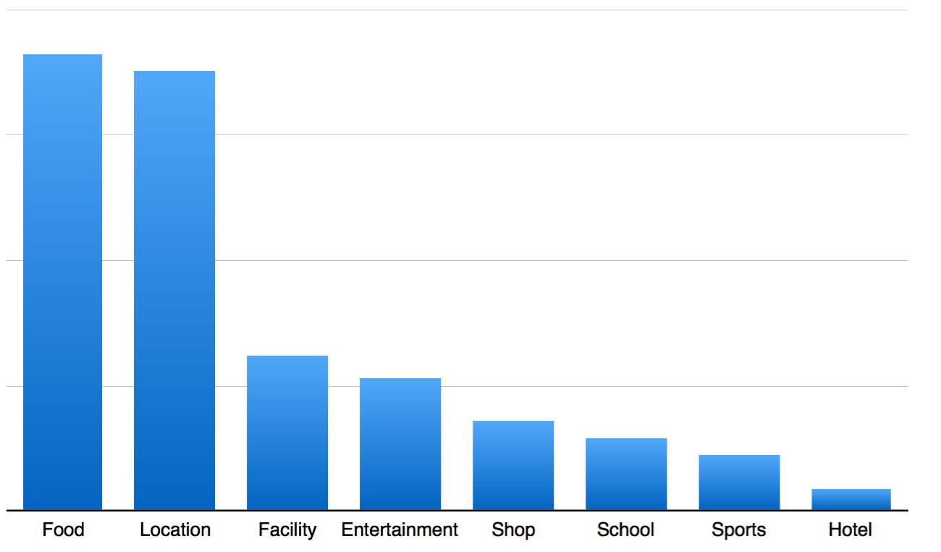
Super Influencers
Checkin location categories

Slide 4
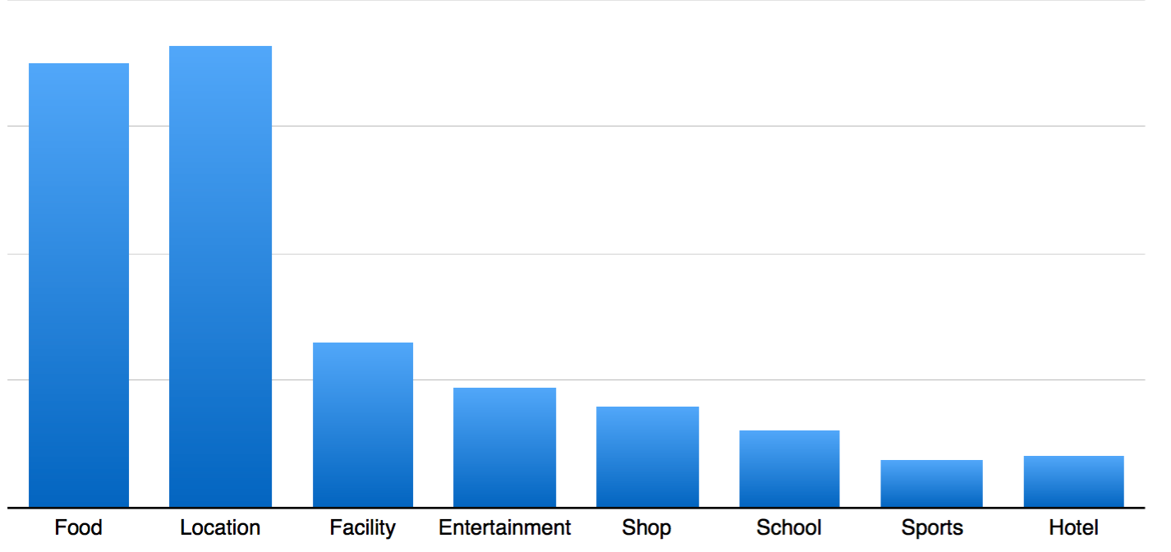
Influencers
Some places that Influencers go that Super Influencers don’t:
Barbecue, Three-star hotels, Game room, Railway station, Auto Repair

Slide 5
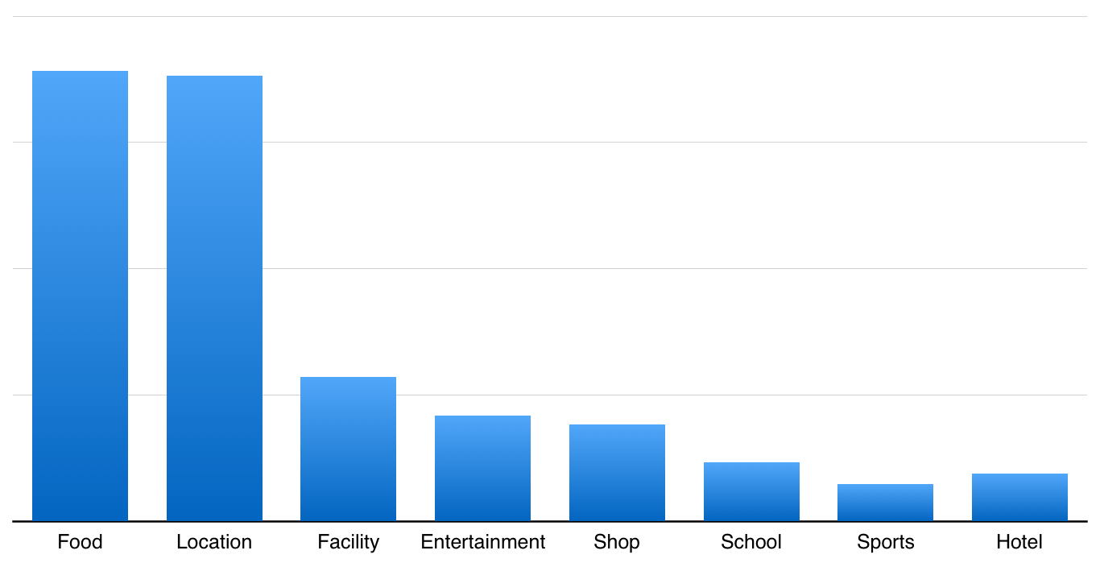
Regular Users
New Location categories:
Gymnasium, Indoor Swimming Pool,Tobacco shops, Chess Room, Jiangsu cuisine, Pet shop

Slide 6
Clustering of Super Influencers
Most frequently checked in locations in Shanghai

Slide 7
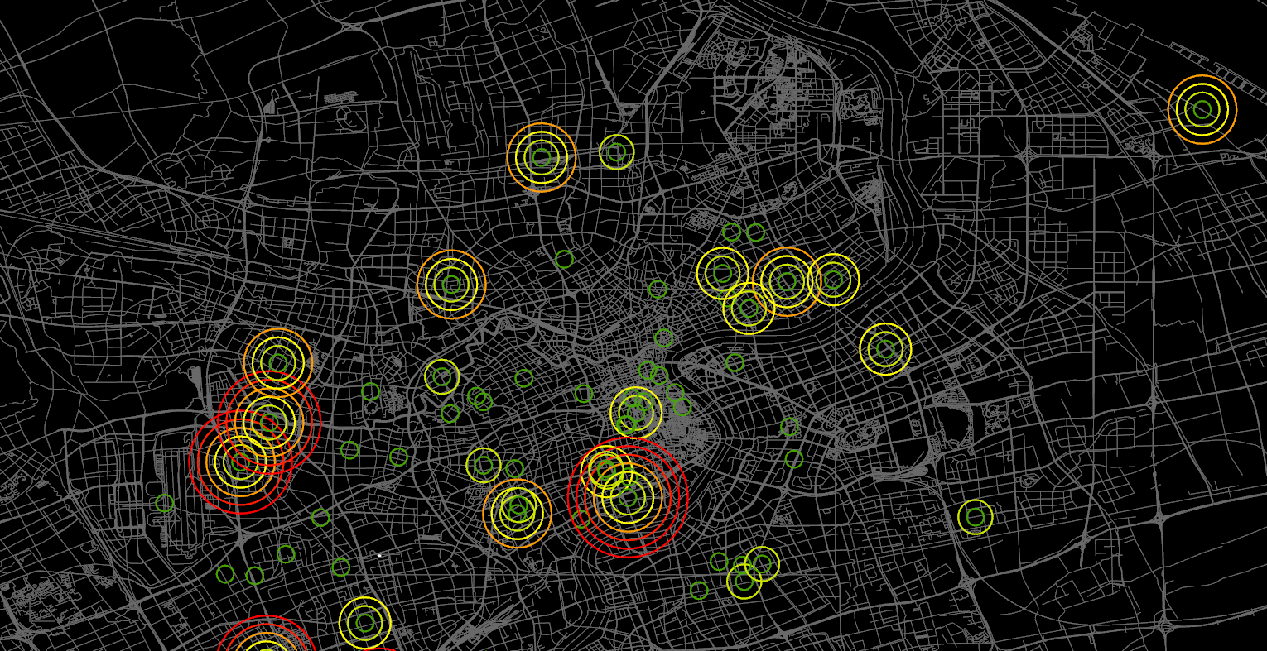
Hot Spots
Super Influencers

Slide 8
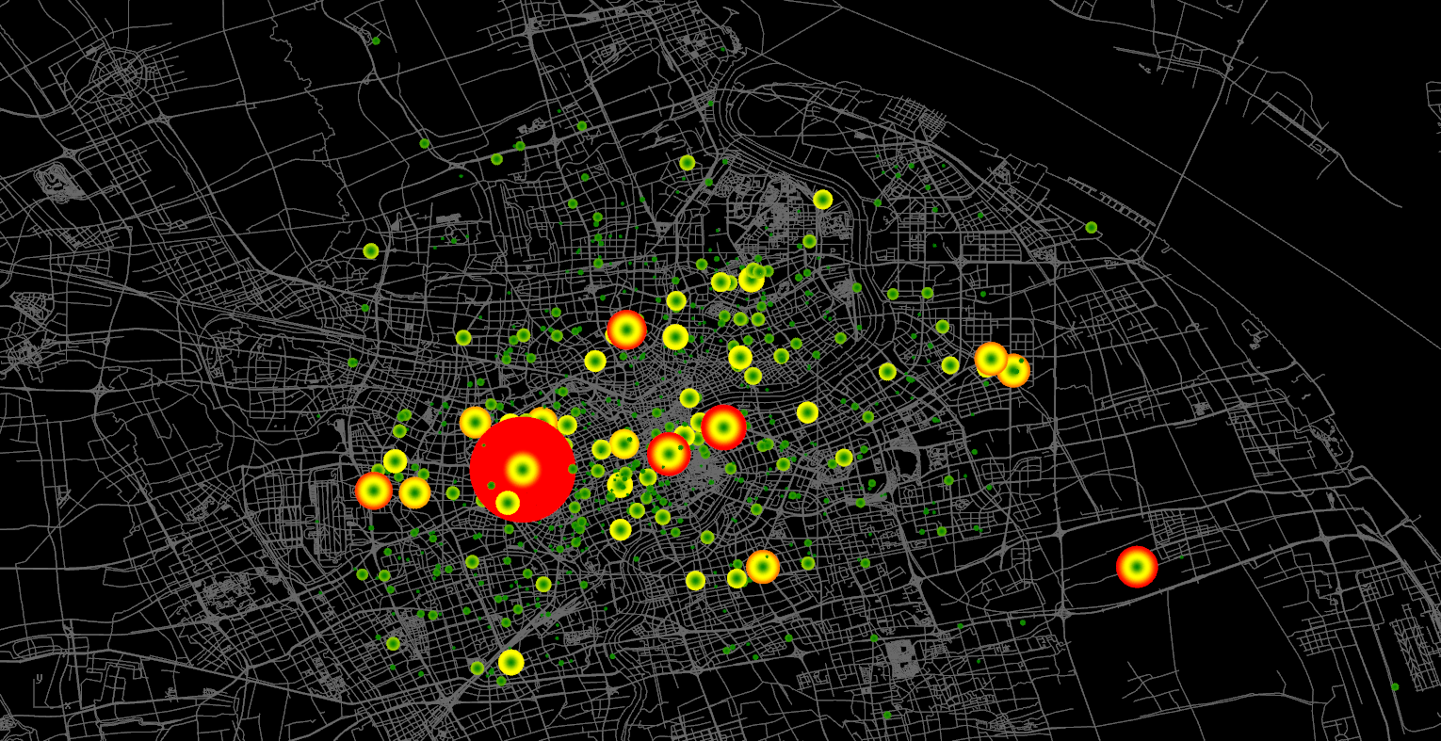
Hot Spots
Influencers

Slide 9
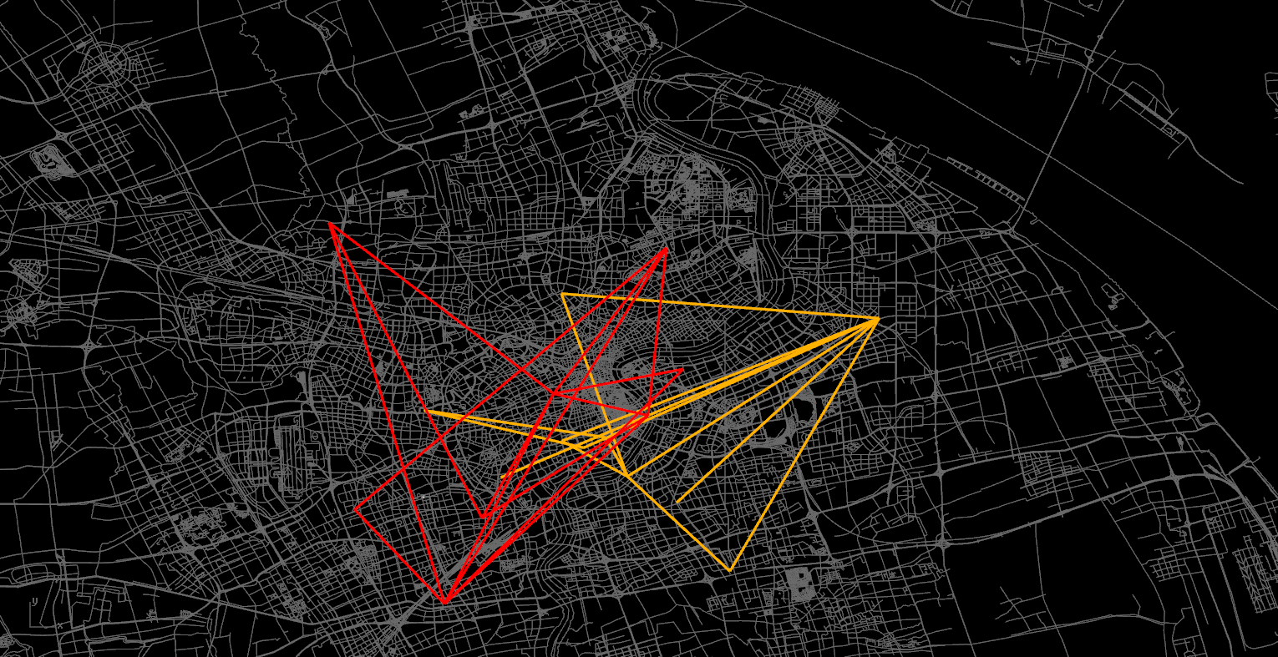
Tracking an active influencer across Shanghai
He has 1,009 friends, 101,565 followers, 1438 checkins, 5 favorites. The director of a Korean cosmetic surgery hospital in Shanghai.

Slide 10
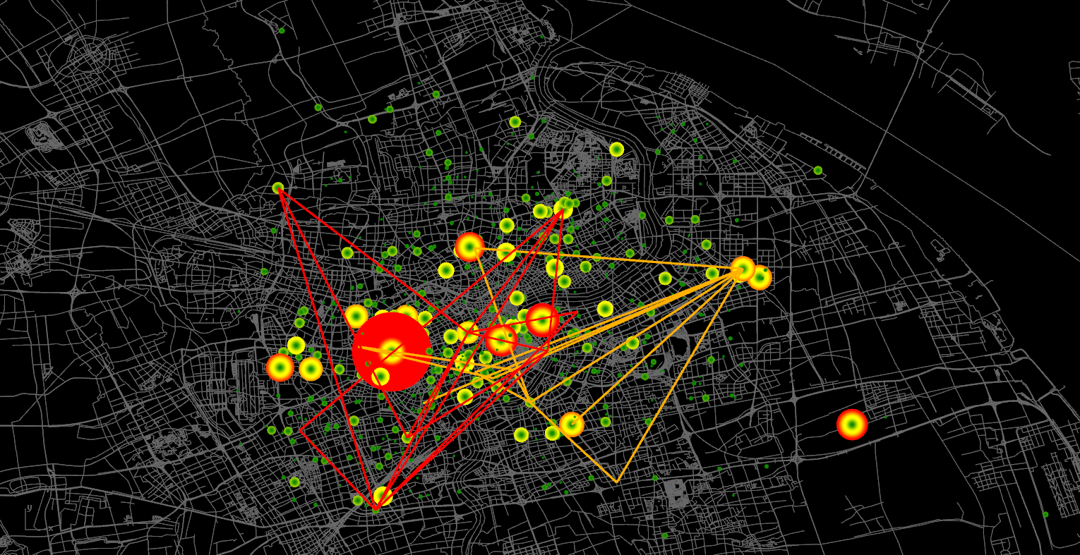
Active Influencer #2
He has 1954 friends, 95,270 followers ,13183 checkins, and 1580 favorites.

Slide 11

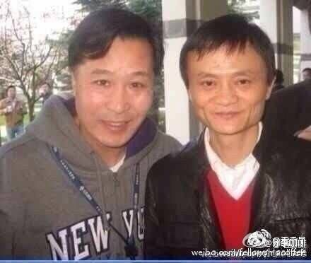
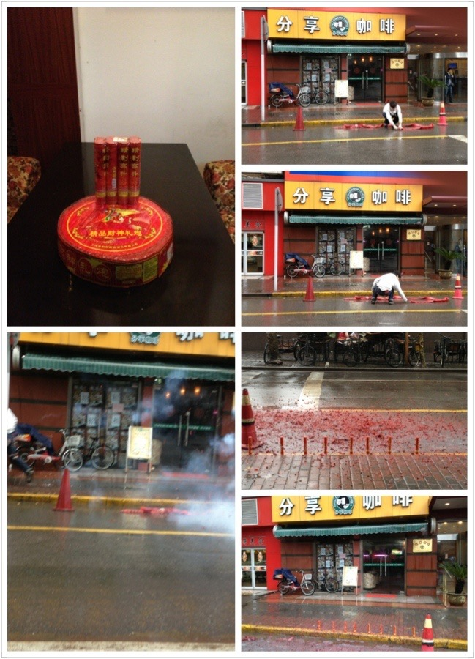
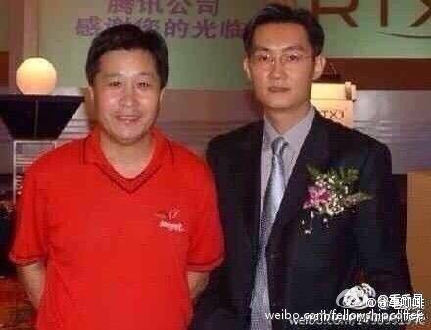
Owner of 'Fellowship Coffee' (分享咖啡 )
Today he has: 110,315 followers and follows 2,074 people

Slide 12
Closing Thoughts
Could apply to urban planning:
What types of venues, and how to increase social network activity
(Turn off geo tagging!)

